Slide 1
SNOW RUSH
Game Pitch

Slide 2
Overview
Snow Rush is a casual mobile 2.5D isometric game intended for Android and iOS.
ESRB Rating: E10 (Everyone 10+)

Slide 3
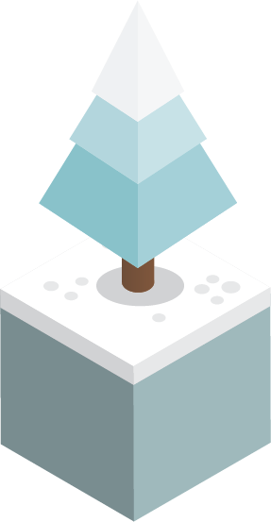




Gameplay
In Snow Rush you play as a Snowboarder whose goal is to get down the hill, which the player will never be able to do since the map is endless, BUT you have to try to get as far as you can avoiding obstacles like:

Slide 4
Gameplay
The environment is set up on a snow hill with trees, rocks, holes, slippery slides and much more. The game automatically slides down the snow hill, so you will have to avoid obstacles, step into different power ups and get as far as you can. Just remember, power ups don’t help at all times. The final score will depend on your travelled distance.

Slide 5
Power Ups
The player will find some power ups on his way down the hill that may be really helpful and sometimes also the only way to keep going, but be careful, they will not always help you.
Here goes an in-game example:

Slide 6

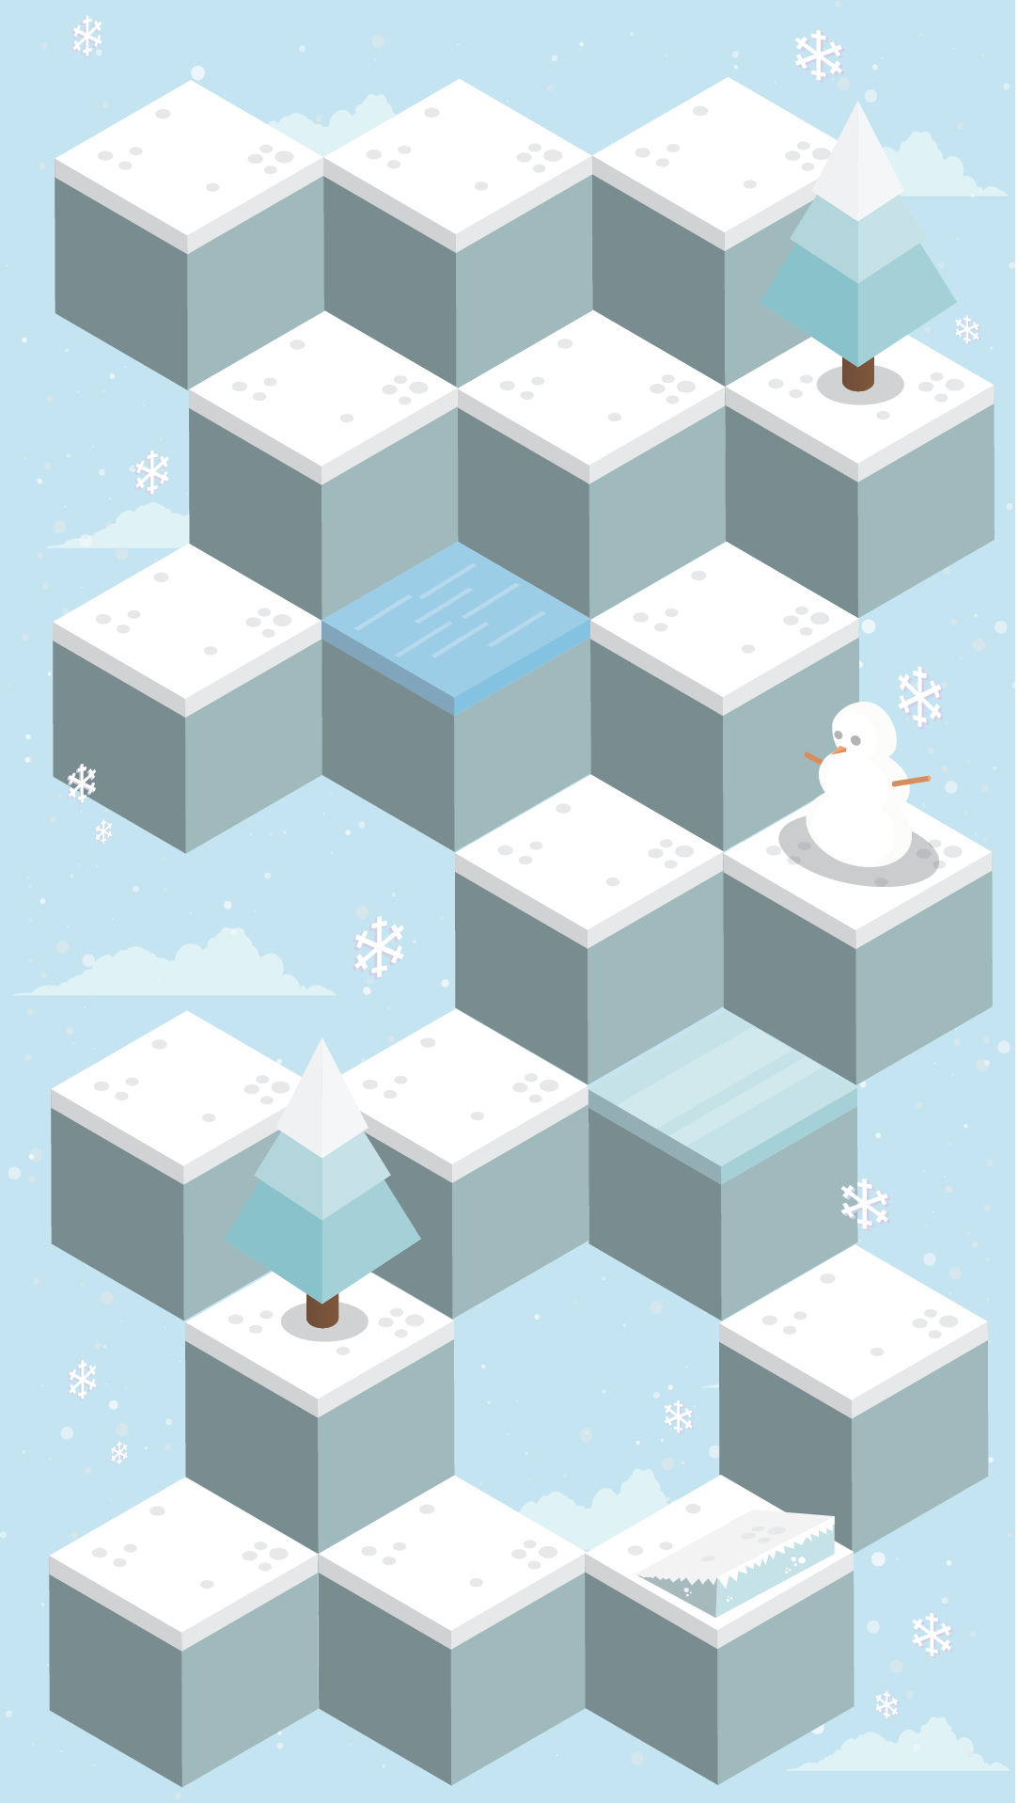

Power Ups
In this case it will help you jumping over the tree
This is the slippery slide:

Slide 7
Power Ups
And here it will help you avoiding the water block, but it will also cause you to fall down and then the game will be over
This is the slippery slide:

Slide 8
Marketing Overview
Snow Rush will be free on all platforms
It will have some in-game purchases
Players will be able to buy different characters
Players will also be able to customize their characters buying them clothes, skates, scarfs, etc.

Slide 9
Development
2 Programers
3 2D Artists
1 Sound Engineer
$5000
3 Months

Slide 10
Any Questions?

